Slide 1

1

Slide 2

INITIATIVE NAME
Category Name: City Problems – Traffic Congestion, Waste Management, Pollution Control, Smart Infrastructure
Group Name: Team_Gliders
Team Members:
i. Umme Hani Punam
ii. Rebeka Sultana Orce
iii. Fahim Bin Zaman
iv. Alvee Ahnaf
v. Shamsul Islam Fahim
2

Slide 3
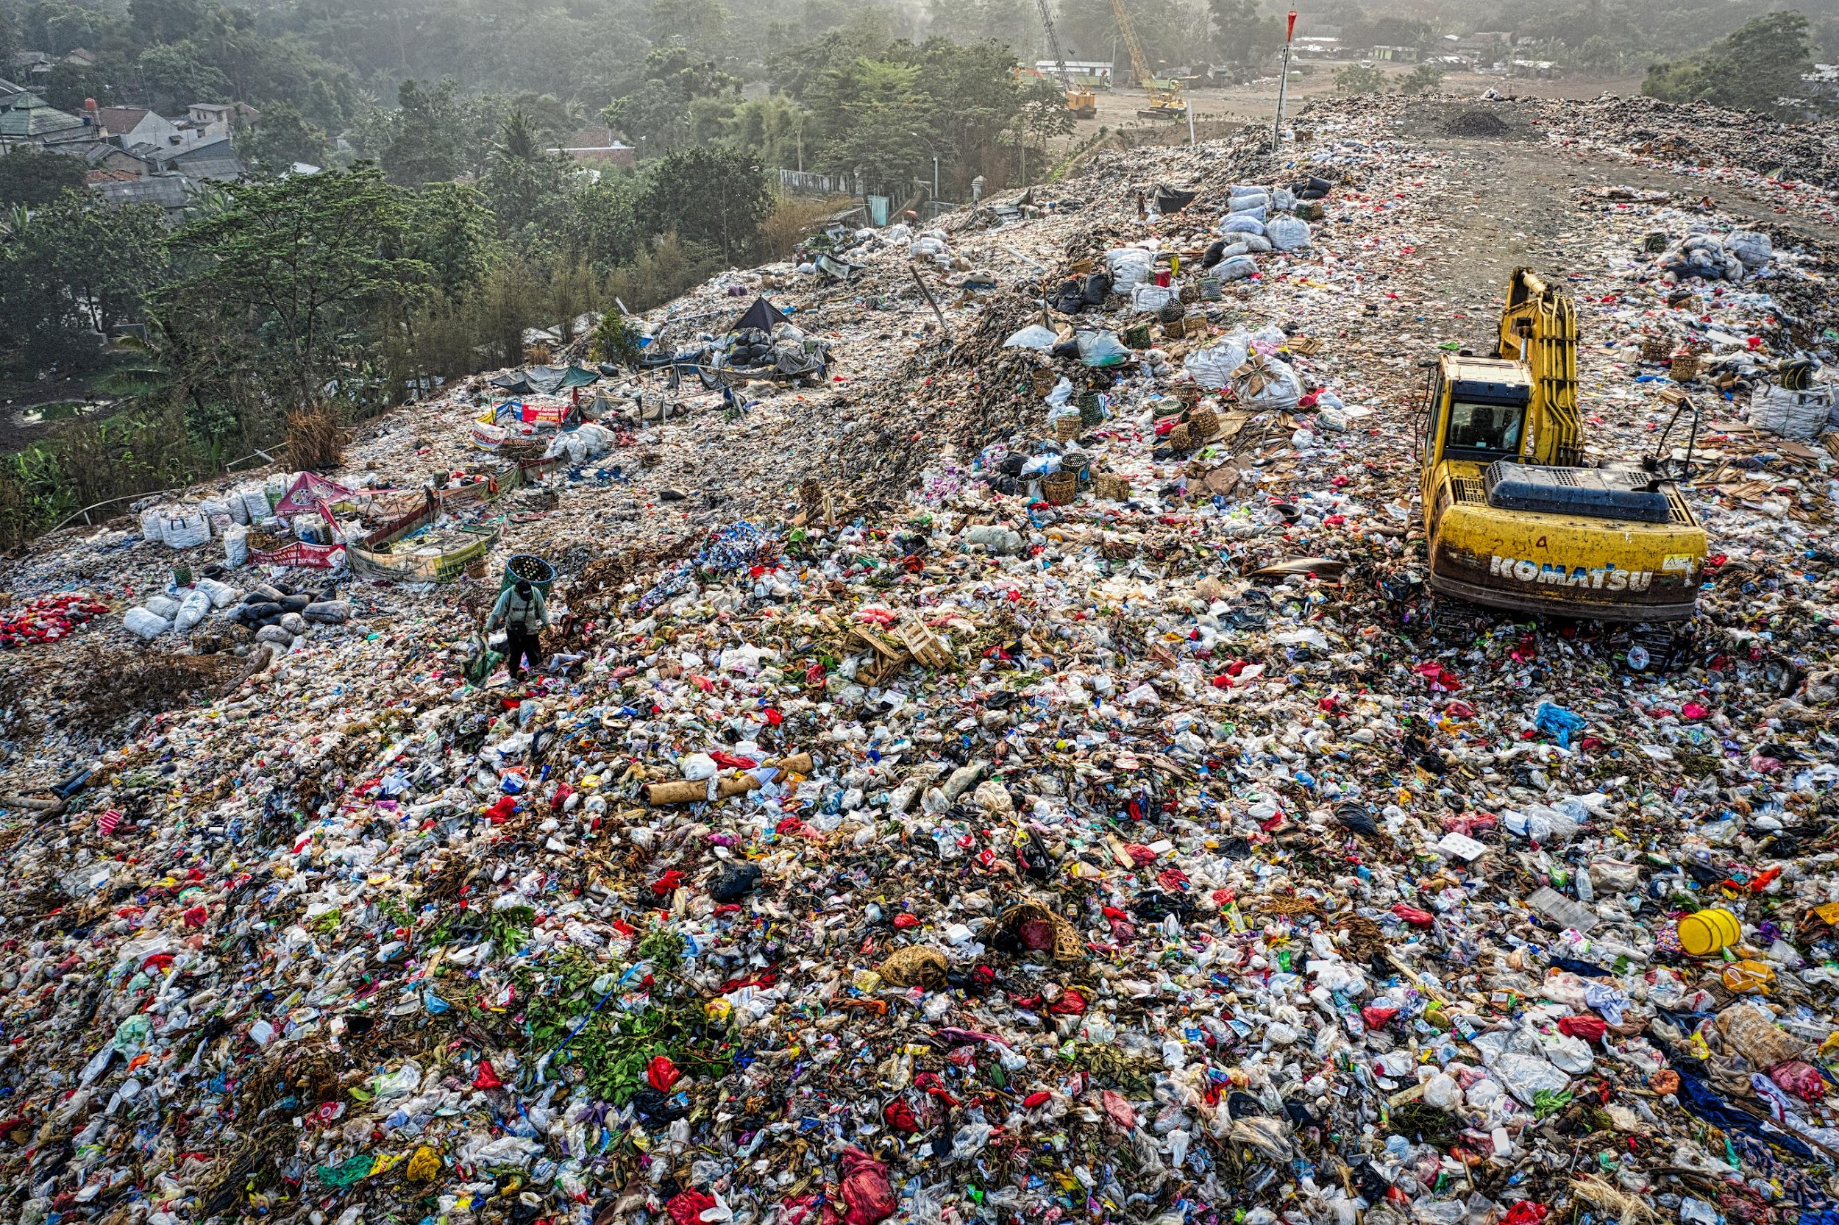




🚮 Waste Crisis in Bangladesh
Dhaka generates 6,500+ tons of waste/day (only 50% collected).
No segregation→ 90% mixed waste → landfills poison soil/water.
Manual workers face health risks (life expectancy: 50 years).
3

Slide 4
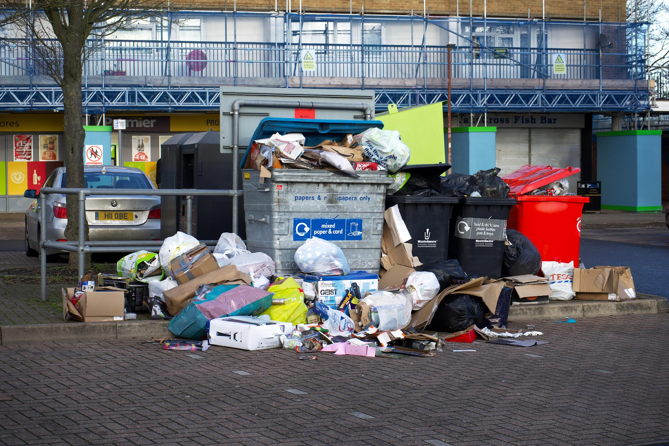
💔 Key Challenges
No real-time monitoring → Bins overflow (Mirpur, Uttara).
Inefficient routes → Trucks waste fuel in traffic.
Recycling rate <10% (Plastic chokes rivers).
4
“সমাধান কি AI-এর হাতে?” (Is the solution in AI’s hands?)

Slide 5

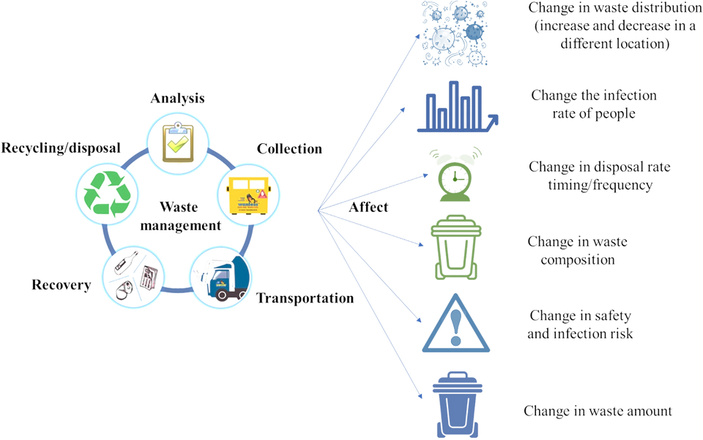
✨ AI for Bangladesh’s Clean Future
✅ Smart Bins in Dhaka:
Fill-level sensors → Alerts to Dhaka South City Corporation.
Bangla NLP voice commands for illiterate users.
✅ Made for Bangladesh:
Solar-powered (load-shedding proof).
Low-cost design (₹5,000/bin).
✅ Impact:
60% less truck fuel → Cut traffic jam waste.
Double recycling rates in 2 years.
5
একটি বুদ্ধিমান ডাস্টবিন, একটি পরিষ্কার বাংলাদেশ (One smart bin, one clean) Bangladesh)

Slide 6
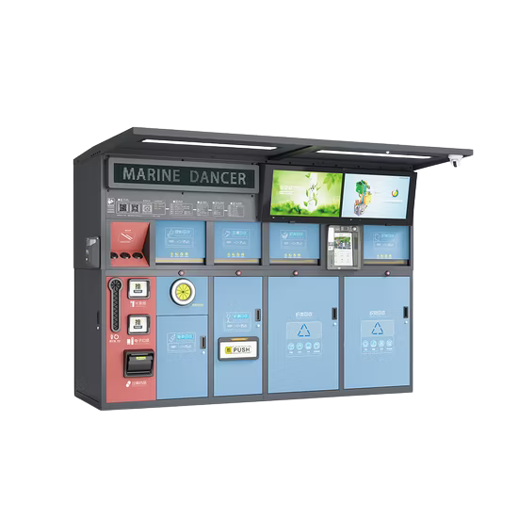
EcoSortha
AI That Sorts for Success
6

Slide 7
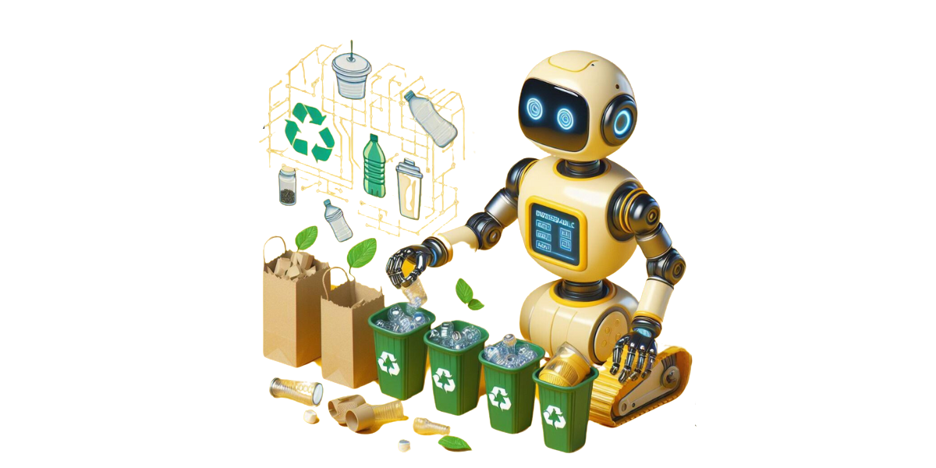
Why EcoSortha??
Save $20M/year in waste management costs (DSCC data)
Protect rivers → Reduce Buriganga’s plastic by 50%.
Jobs: 10,000+ roles in AI maintenance/recycling.
🇧🇩 Aligned with Vision 2041
Smart cities + SDG 12 (Responsible Consumption).
7
AI দিয়ে স্বচ্ছ বাংলাদেশ” (Transparent Bangladesh with AI)

Slide 8
Why EcoSortha??
Hypothesised Outcome
Optimisation Waste Collection: Reduces fuel & labor cost through real-time monitoring.
Decreased Overflowed Bins: Encourages on-time garbage disposal, keeping communities clean.
Advanced Recycling: AI-empowered sorting for a sustainable future
Better Hygiene & Automation : Automation of smart bins reduces contact with the garbage. This AI-driven waste disposal system will increase efficiency, reduce pollution, and help create a sustainable city ecosystem.
8
AI দিয়ে স্বচ্ছ বাংলাদেশ” (Transparent Bangladesh with AI)

Slide 9

AI In Waste Minimization
The most efficient way of managing waste is not producing it at all
9

Slide 10

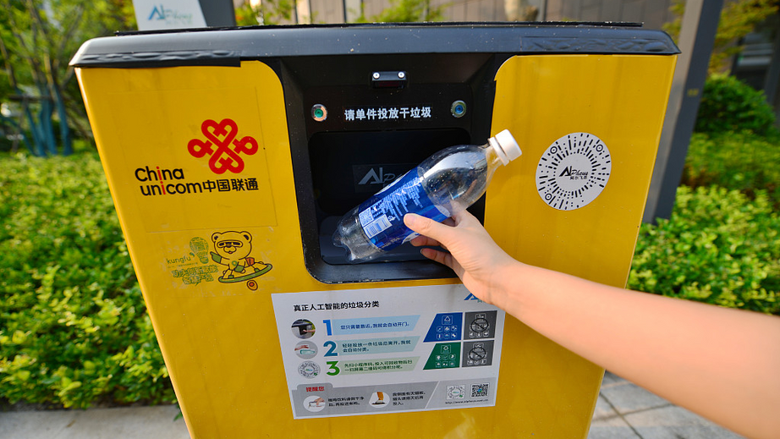
AI In Waste Minimization
AI Driven Garbage Segregator
Smart Dustbin
10

Slide 11
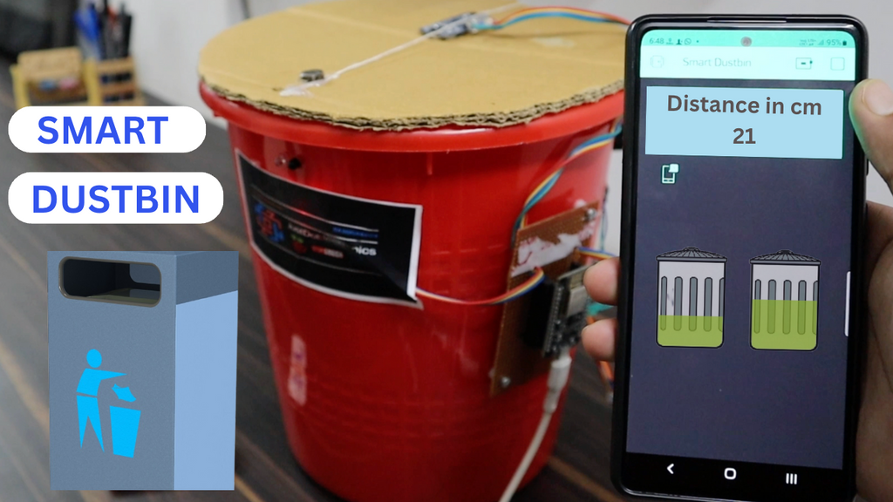
Smart Dustbin
Features
Sensor Integration
Smart Fill-Level Monitoring
Automated Compaction & Volume Reduction
Energy Efficiency & Sustainability
IoT & Real-Time Alerts
Efficient Motor Control
Working Process: Sensor detection → Data processing → Automated lid operation → Data transmission.
11

Slide 12
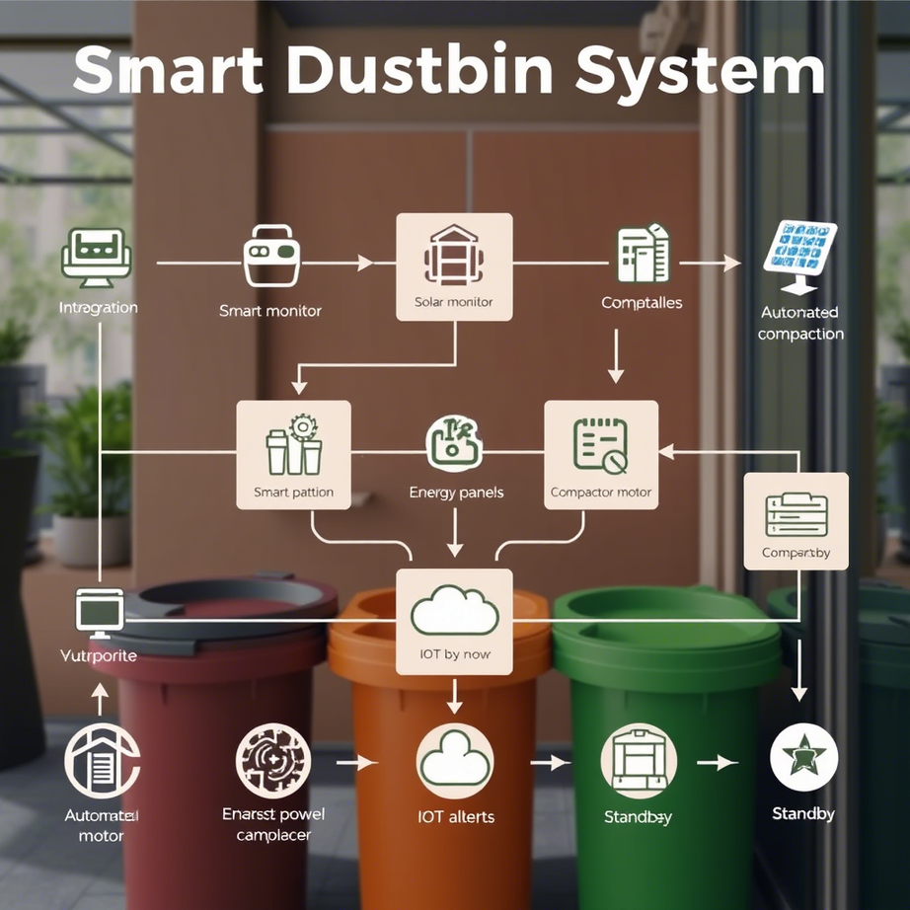
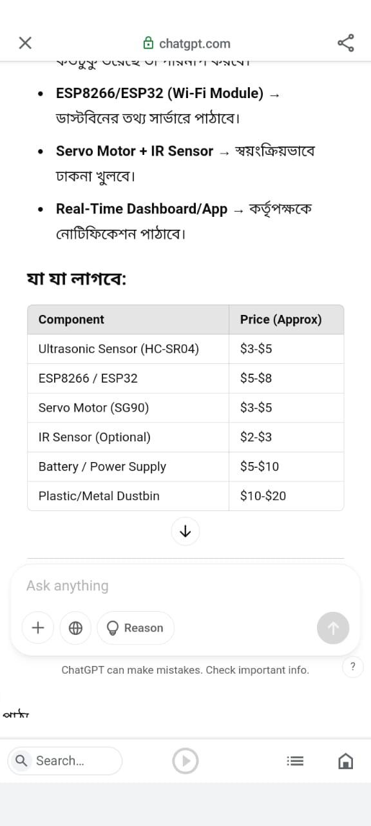
Smart Dustbin
Working Process
Costing & Components
12

Slide 13
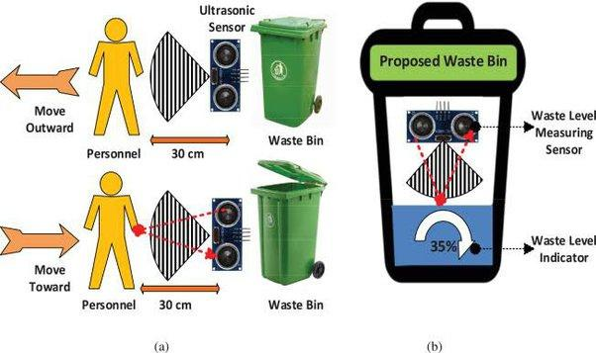
Smart Dustbin
Working Process
1. Sensor Integration & Data Collection:
Fill-Level Sensor (Ultrasonic/Weight) → Monitors waste volume Motion Sensor → Detects user presence Waste Type Sensor (Optional Camera/ML) → Identifies material
2. Smart Fill-Level Monitoring:
If bin ≥80% full → Trigger Auto-Compaction If bin ≤80% full → Return to standby mode
13

Slide 14
Smart Dustbin
Working Process
3. Smart Fill-Level Monitoring:
If bin ≥80% full → Trigger Auto-Compaction
If bin ≤80% full → Return to standby mode
4. Automated Compaction & Volume Reduction:
Compactor Motor Activates (if waste exceeds threshold)
Solar-Powered Compaction (if enabled)
Volume Reduced → Re-check Fill-Level
14

Slide 15
Smart Dustbin
Working Process
5. Energy Efficiency & Sustainability Check
Solar Panel → Powers compaction/sensors (if daylight)
Battery Mode → Switches to grid/low-power at night
Efficient Motor Control → PWM/ML optimizes power use
6. IoT & Real-Time Alerts
If bin ≥95% full after compaction →
Send Alert (Wi-Fi/GSM) to waste collector
Update Cloud Dashboard (bin location, fill-rate)
15

Slide 16

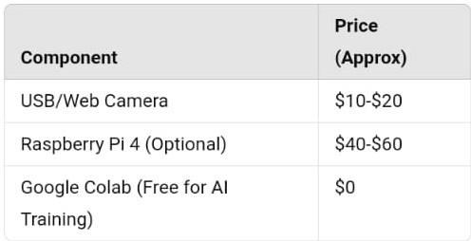
AI Driven Garbage Segregator
Costing
16

Slide 17
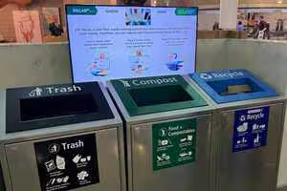
AI Driven Garbage Segregator
Features
AI & Machine Learning Integration
Motion-Triggered Processing
Wireless Communication
Edge Processing
Working Process: Real-time monitoring → Garbage detection → Action triggering → Data transmission
17

Slide 18
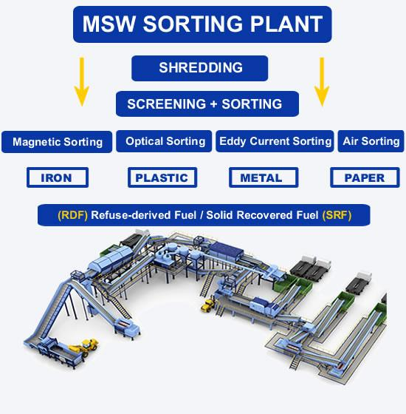
AI Driven Garbage Segregator
Working Process
Real-Time Monitoring:
The camera or sensors continuously monitor the environment.
Garbage Detection:
An AI model analyzes images or video feeds to identify garbage.
Action Trigger:
Once garbage is detected, the system triggers appropriate actions (e.g., notifications, alerts, or automated responses).
Data Transmission & Logging:
Processed data is transmitted to the cloud or local network for logging and further analysis.
18

Slide 19
AI can be used to minimize waste in 3 ways
1
2
3
Helping to efficiently use energy
Streamlining process using AI to produce less waste
Using predictive analysis
19

Slide 20
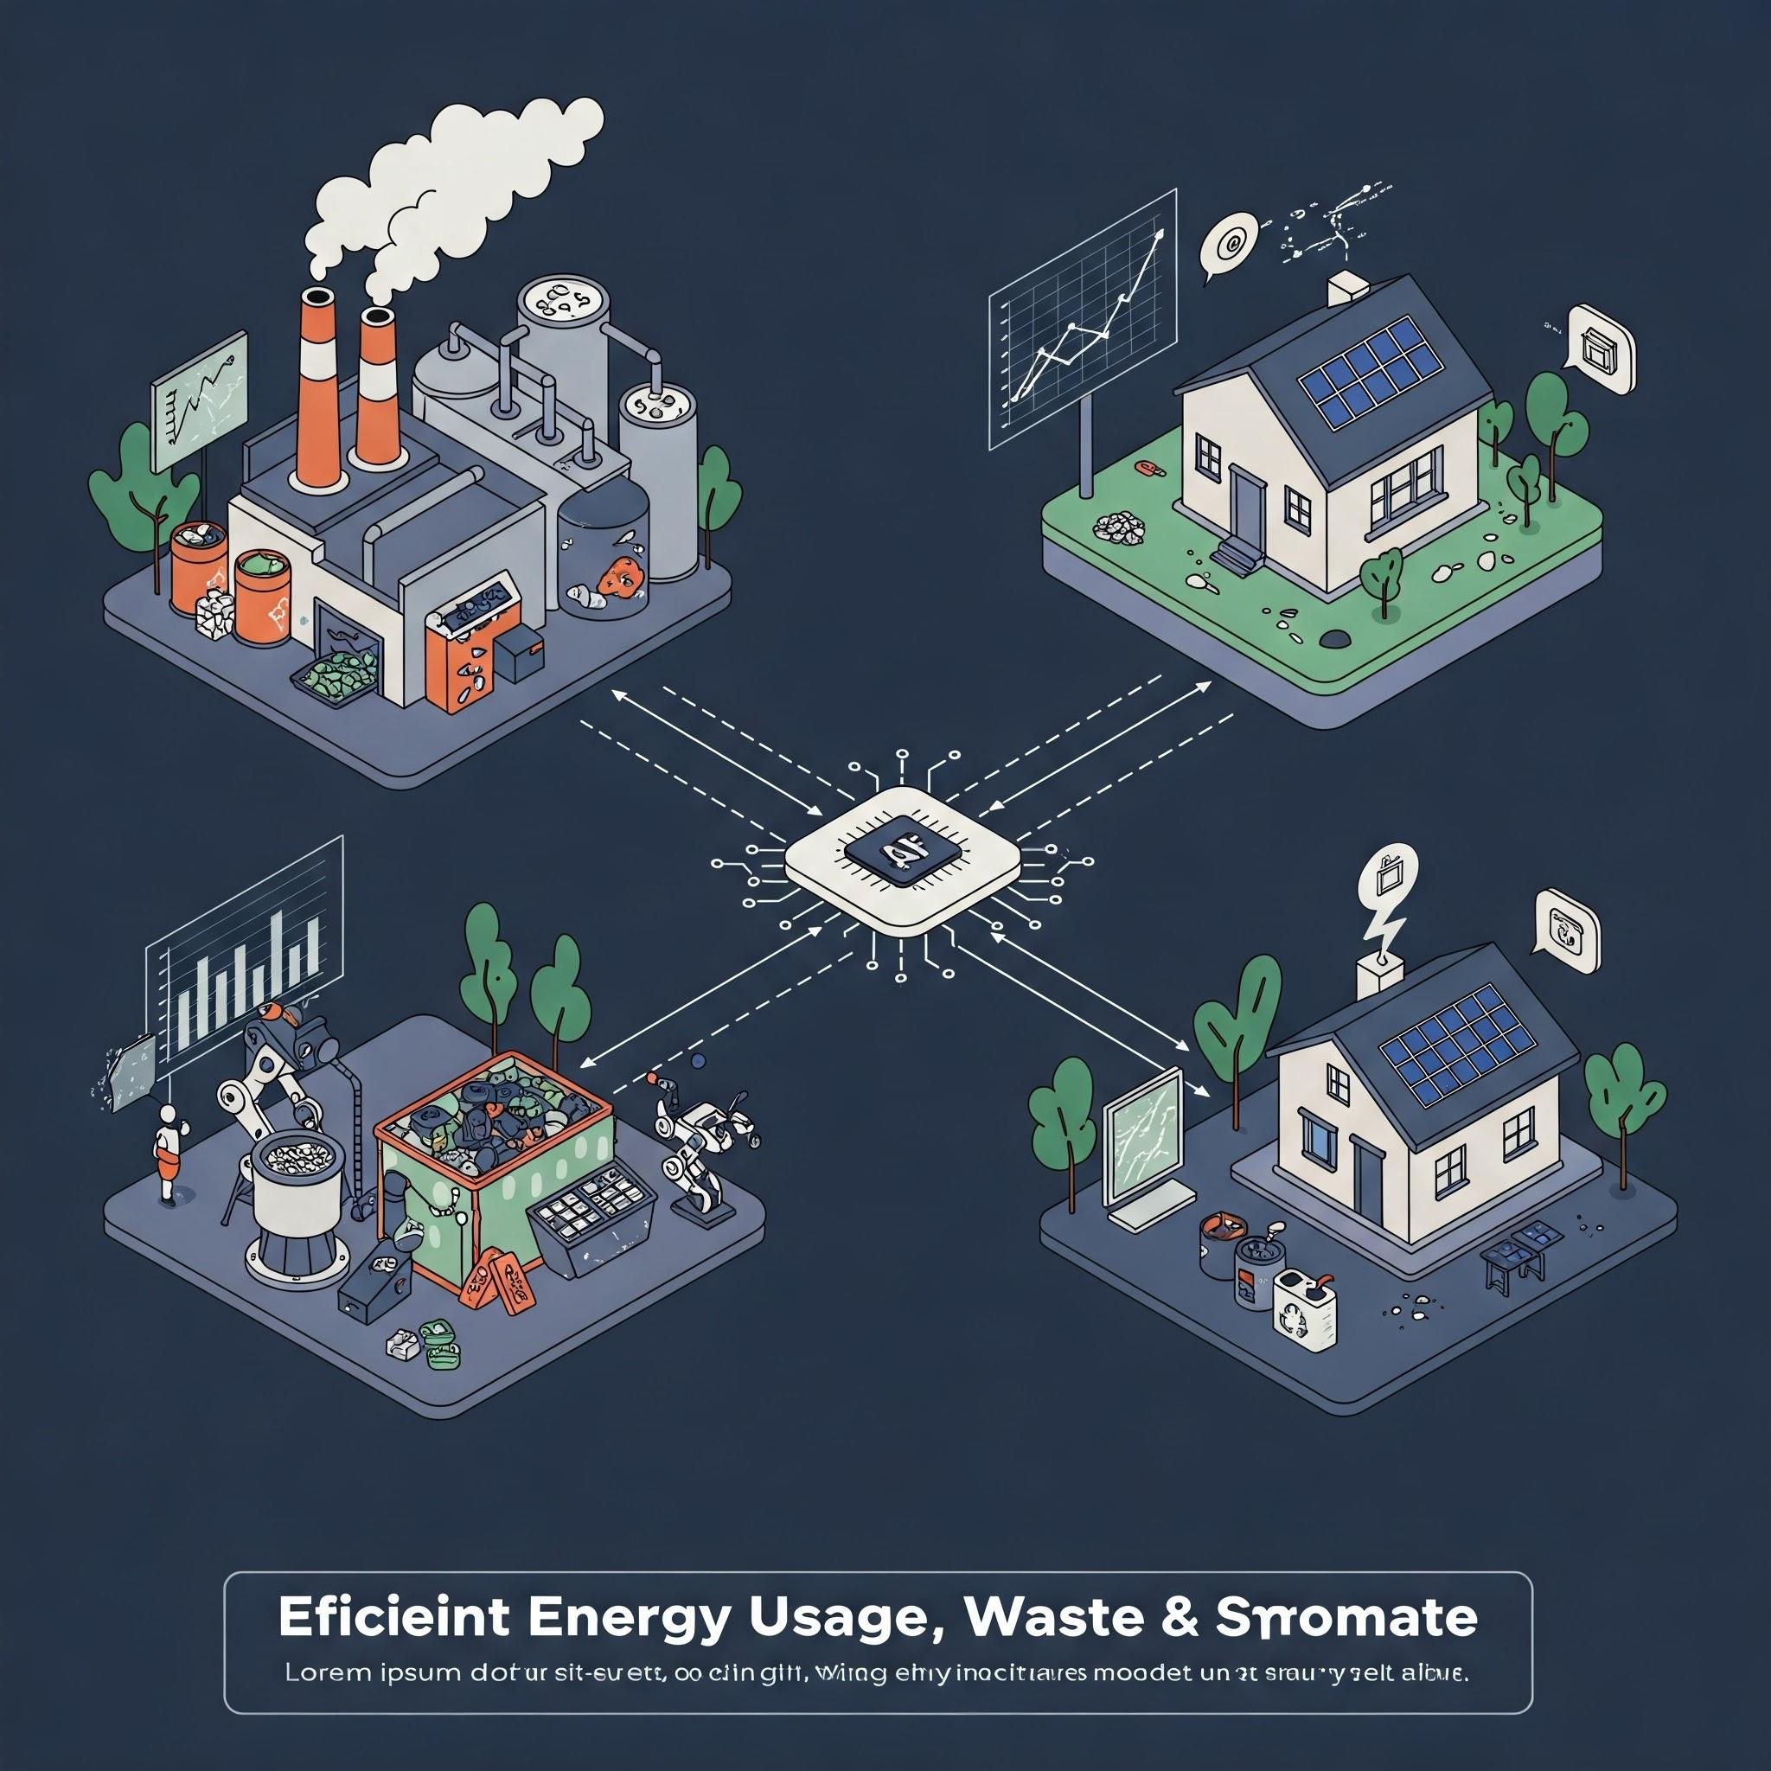
Efficient Energy Usage, Waste & AI
20

Slide 21
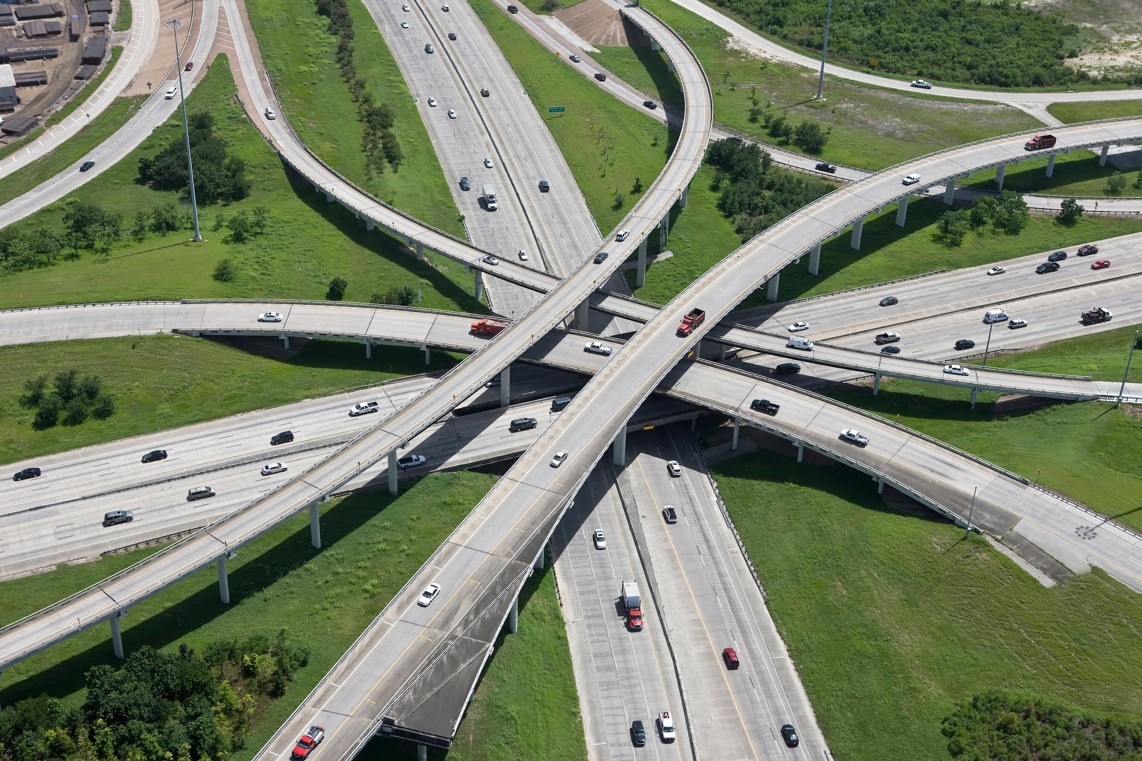

Optimizing energy consumption in buildings and factories through AI
Less Energy= Less Waste!
Developing more efficient transportation systems Through AI
21

Slide 22
Maximizing AI usage for energy efficiency can give results in producing less waste
Generally by a rule of thumb it is accepted that the less the energy usage the less the produced waste
AI can be used to optimize traffic flow and reduce fuel consumption and reduced mileage. Less mileage of vehicles means less waste
AI algorithms can analyze data on energy usage and identify patterns that can be used to improve efficiency in factories and buildings
Since AI efficiently manages energy, it lessens the demand for generating more energy and thereby ensures less waste emission
22

Slide 23
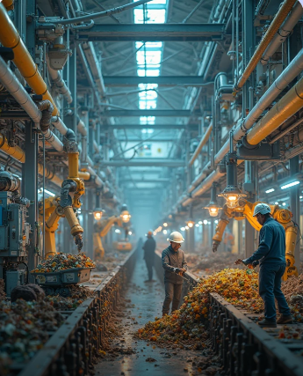
Streamlining process using AI to produce less waste
Traditional processes often lead to waste of materials, time, and resources. AI-powered process optimization identifies and eliminates inefficiencies. This leads to reduced waste and costs.
23

Slide 24
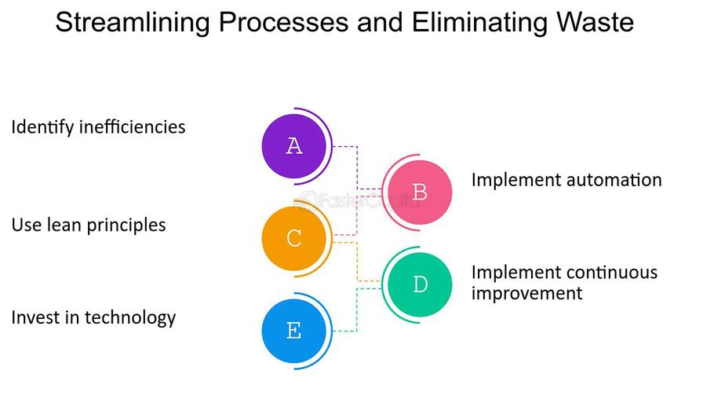
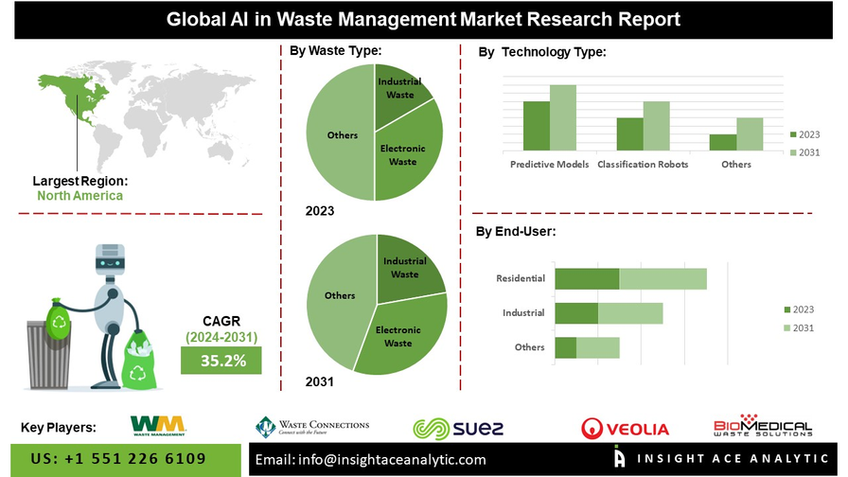
AI-Driven Waste Reduction in Action
1.AI Workforce vs. Human Workforce in Waste
Management
Speed & Accuracy: AI-powered sorting robots process 80 items per minute, while humans manage 30-50 items per minute. (Source: AMP Robotics)
Cost Reduction: AI reduces operational costs by 30-50% compared to human-led waste sorting. (McKinsey Report, 2023)
Error Reduction: AI sorting accuracy is 99%, whereas human error leads to 10-20% misclassification in recycling plants. (Waste Management Research, 2022)
24

Slide 25
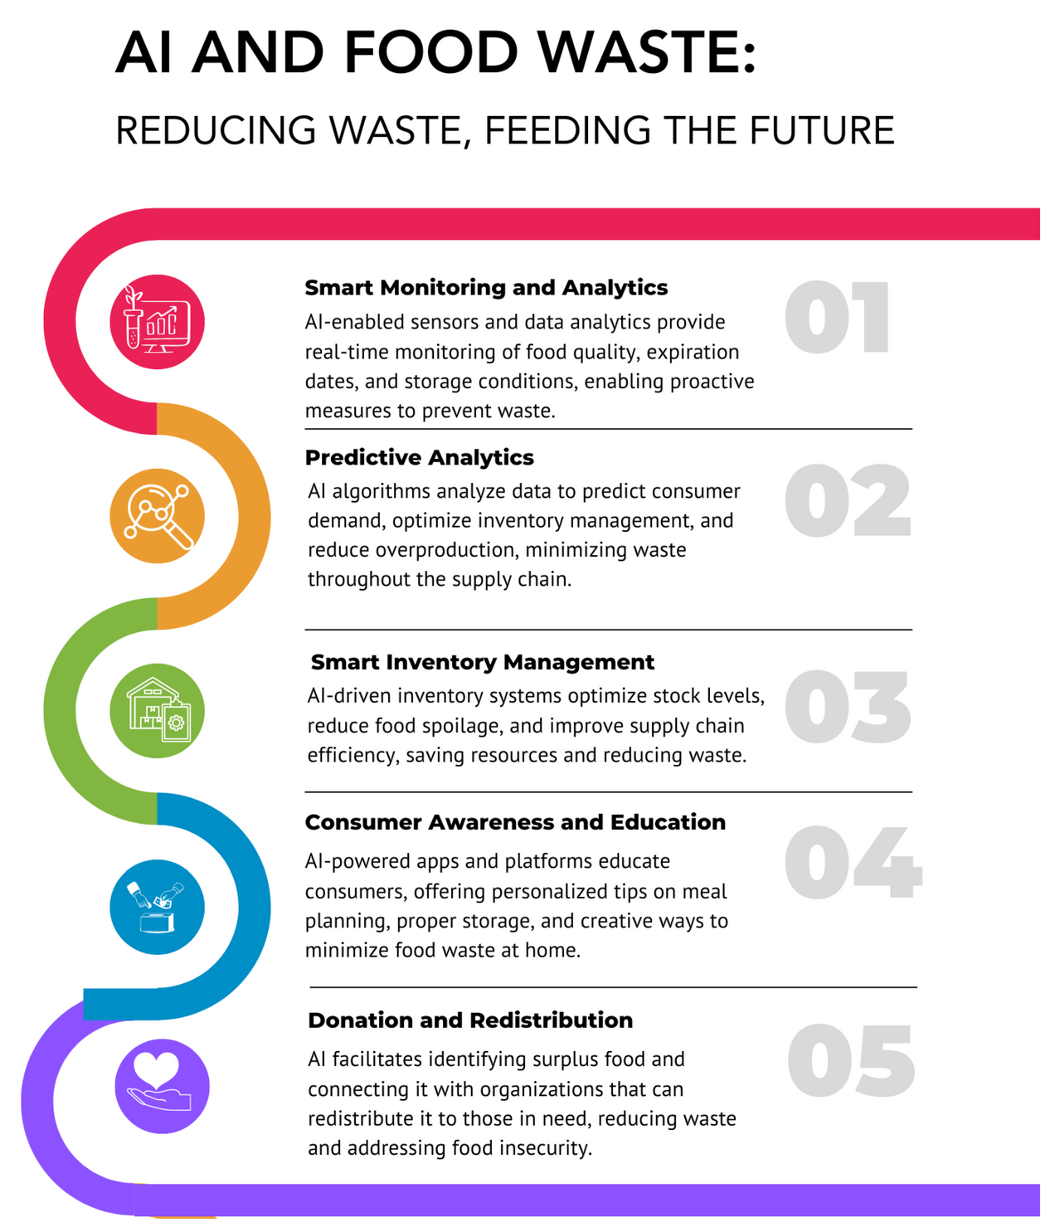
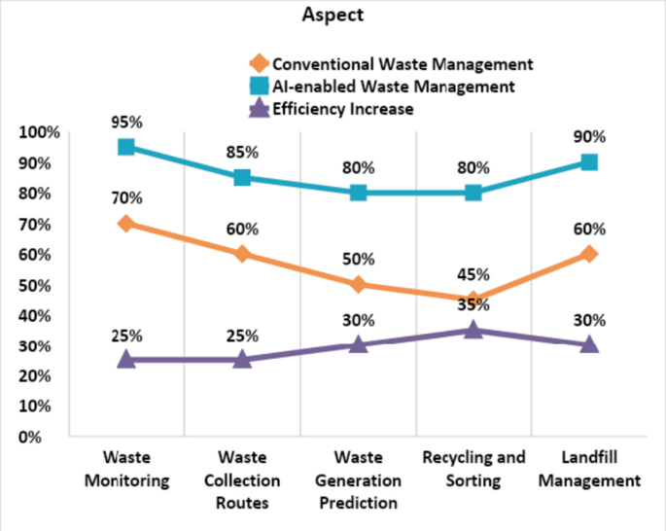
Streamlining process using AI to produce less waste
2.AI Reduces Waste by Minimizing Human Involvement
Humans cause inefficiency through mismanagement, errors, and inconsistent performance.
AI-based smart factories reduce material waste by 30-40% through predictive analytics and process automation. (Siemens Data, 2023)
AI-powered automated food tracking reduces food waste by 20-25% in households and supermarkets. (FAO Report, 2022)
25

Slide 26
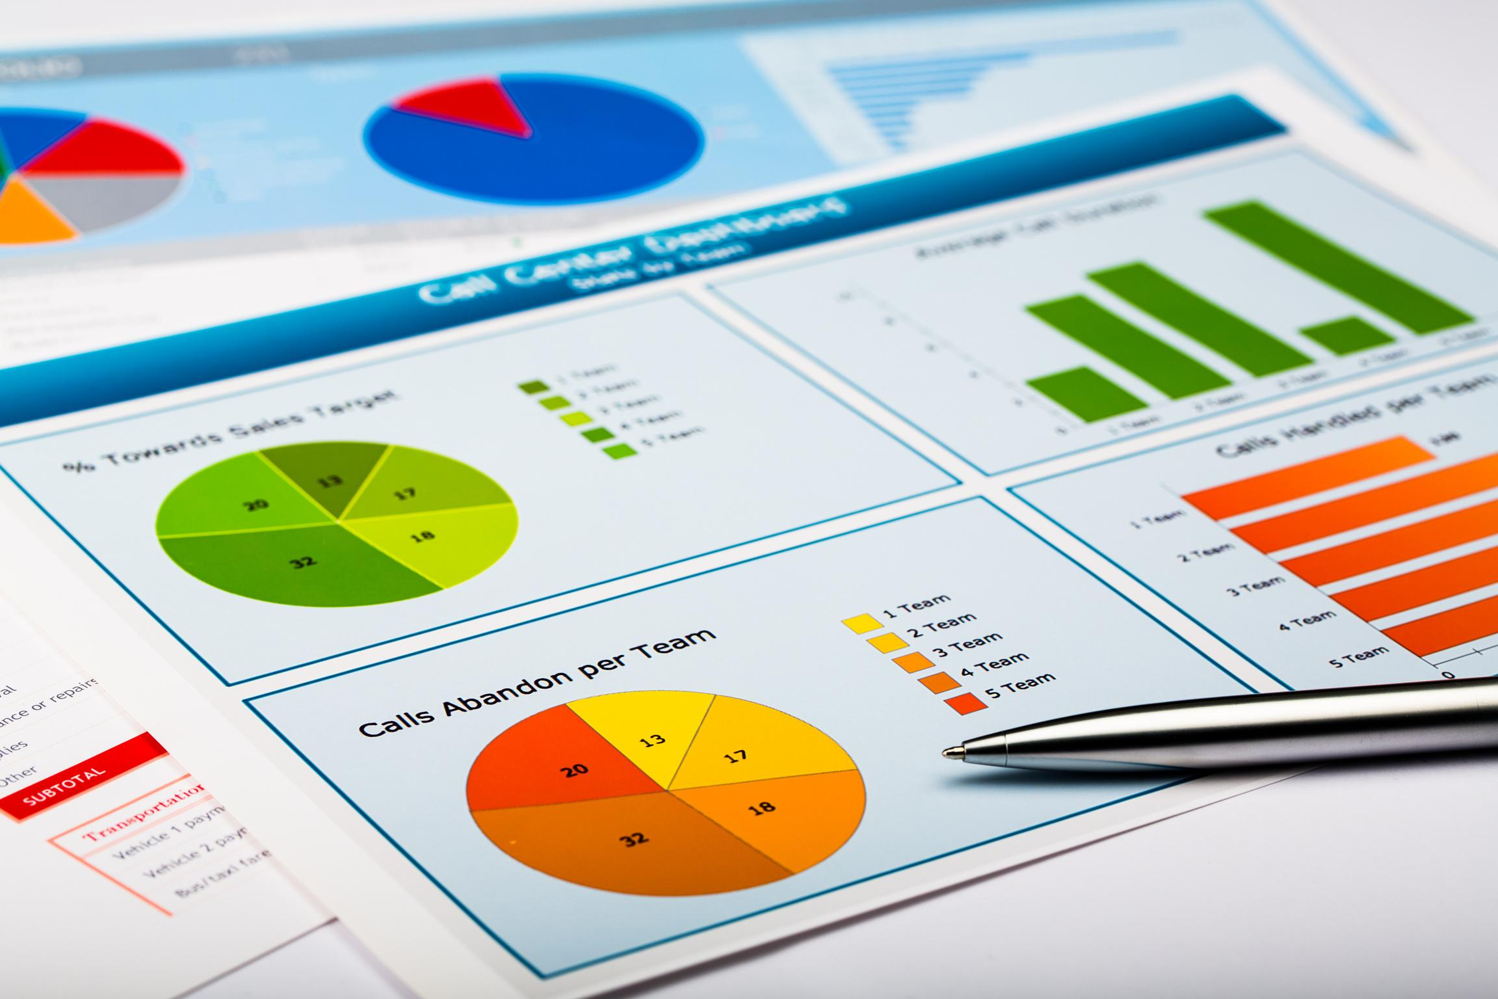
Using predictive analysis
26

Slide 27

What is Predictive Analysis?
Predictive analytics is the process of using data to forecast future outcomes.
Predictive analytics uses data, mathematical models, and statistical methods to forecast the likelihood of future outcomes by examining past data.
What makes AI predictive analytics different from standard predictive analytics? Essentially, AI predictive analytics uses AI to make predictions about future events and answer questions about how likely (or not) it is for something to happen.
27

Slide 28
Predictive Analysis For Waste Management
Analyzing Waste
Overproduction
Predictive Maintenance
Inventory
AI-driven demand forecasting to align production with needs preventing both over and undershooting
Predictive maintenance to anticipate failures and schedule proactive maintenance.and thereby minimizing waste
AI transforms manufacturing by identifying potential waste sources.
Predictive inventory management for just-in-time stocking
28

Slide 29
Successful Implementations of AI for Waste Reduction
UK Grocery Store Chain: 35% reduction in unsold perishables.
Walmart (Eden): $86 million prevented in food waste, aiming for $2 billion.
Delta Airlines: 98% reduction in in-flight component failures.
Unilever: 64% reduction in operational emissions through supply chain optimization.
29

Slide 30
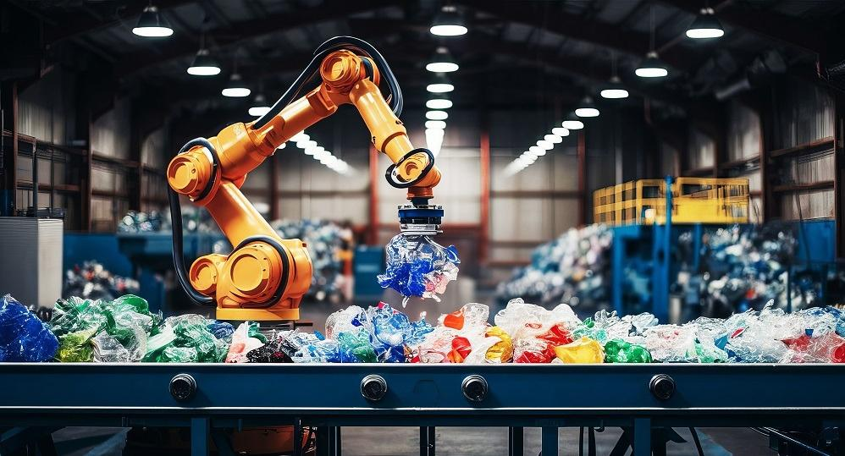
Revolutionizing Recycling: AI-Powered Waste Separation
Discover how AI can revolutionize recycling, enhance efficiency and drastically improve waste management, turning today's challenges into opportunities for a sustainable future.
30

Slide 31

The Recycling Crisis:
A Pressing Issue
Low Recycling Rates
Only 31% of the 977,000 tonnes of plastic
consumed in 2020 were recycled in
Bangladesh.
High Contamination
25% of materials are too contaminated to
recycle.
Economic Impact
Inefficient sorting increases costs and
reduces value.
31

Slide 32



AI-Powered Recycling: A Smarter Solution
Computer Vision
Machine Learning
Robotic Arms
Identifies and sorts recyclable materials.
Trained on vast datasets for accuracy.
Precisely picks and sorts materials.
32

Slide 33
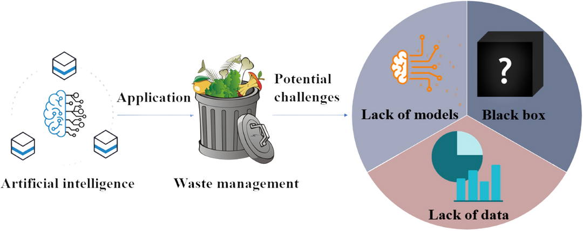
RESPONSIBLE AI USAGE STATEMENT
Ethical Considerations and Limitations :
Privacy & Data Security
Bias & Fairness
Social & Economic Equity
Transparency & Accountability
Safety & Reliability
33

Slide 34
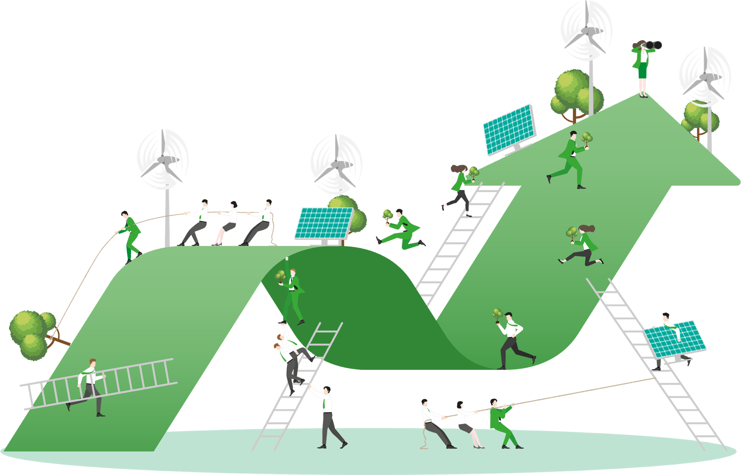
RESPONSIBLE AI USAGE STATEMENT
Future development plans :
AI-Based Route Optimisation
Citizen Reporting System
AI-Based Waste Recycling
Blockchain-Based Waste Management
Waste to Resource
34

Slide 35
THANK YOU
35

